Slide 1
Microorganisms causing the respiratory tract infections

Slide 2
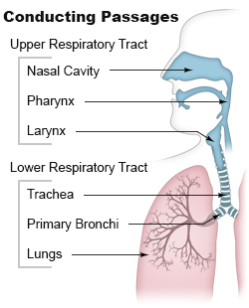
Respiratory tract
Divided into:
Upper respiratory tract
Lower respiratory tract

Slide 3
Infections of the respiratory tract are grouped according to their symptomatology and anatomic involvement. Which are as follows:-
Upper Respiratory Infections
Lower Respiratory Infections
Respiratory tract infections (RTIs) can be caused by viruses, bacteria and (less often) fungi and parasites.

Slide 4
Mode of transmission
Organisms gain entry to the respiratory tract by inhalation of droplets and invade the mucosa. Epithelial destruction along with redness, edema, hemorrhage and sometimes an exudate.

Slide 5
Upper Respiratory Infections:
Common Cold
Sinusitis
Tonsilitis,
Pharyngitis
Epiglottitis
Otitis
Laryngotracheitis.
(Most upper respiratory infections are caused by viruses)

Slide 6
Lower Respiratory Infections:
bronchitis,
bronchiolitis,
pneumonia and
pulmonary tuberculosis .
Although viruses, mycoplasma, rickettsiae and fungi can all cause lower respiratory tract infections, bacteria are the dominant pathogens; accounting for a much higher percentage of lower than of upper respiratory tract infections.

Slide 7
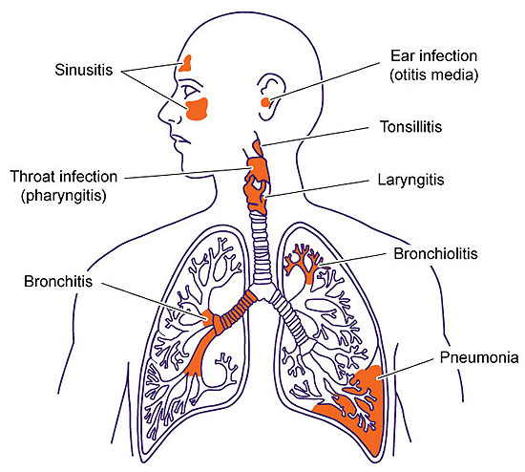

Slide 8
Upper respiratory infections
Common cold:
The common cold (also known as nasopharyngitis, rhinopharyngitis, acute coryza, head cold, or simply a cold) is a viral infectious disease of the upper respiratory tract which primarily affects the nose.
Caused by Rhinoviruses, Coronaviruses, Parainfluenza viruses, respiratory syncytial virus, Adenoviruses and Influenza viruses
Sinusitis
Sinusitis is an acute inflammatory condition of one or more of the paranasal sinuses.
1. Acute sinusitis caused by rhinoviruses, coronaviruses, and influenza viruses, adenoviruses, human parainfluenza viruses.The most common bacterial agents responsible for acute sinusitis are Streptococcus pneumoniae, Haemophilus influenzae, and Moraxella catarrhalis. Other organisms including Staphylococcus aureus, Streptococcus pyogenes
2. Chronic sinusitis is commonly a mixed infection of aerobic and anaerobic organisms. Staphylococcus aureus

Slide 9
Otitis: Infections of the ears
Otitis externa is an infection involving the ear canal. Caused by Staphylococcus epidermidis, Staphylococcus aureus, Propionibacterium acnes , Pseudomonas aeruginosa
Otitis media denotes inflammation of the middle ear. Caused by Streptococcus pneumoniae, Hemophilus influenzae , Moraxella catarrhalis.

Slide 10
Pharyngitis
Pharyngitis is an inflammation of the pharynx. Caused bacterial, viral and fungal.
Most cases are due to viral. coxsackieviruses adenovirus and herpes simplex virus,
Bacteria: Streptococcus pyogenes, Corynebacterium diphtheriae Corynebacterium haemolyticum, Neisseria gonorrhoeae, and Chlamydia trachomatis, Mycoplasma hominis
Fungi: Candida albicans

Slide 11
Epiglottitis: inflammation of epiglottis. Haemophilus influenzae , particularly in children age 2 to 5 years. Epiglottitis is less common in adults. Some cases of epiglottitis in adults may be of viral origin.
Tonsillitis: is inflammation of the tonsils most commonly caused by viral or bacterial infection. adenovirus, rhinovirus, influenza, coronavirus, and respiratory syncytial virus.
Less common bacterial causes include: Staphylococcus aureus, Streptococcus pneumoniae, Mycoplasma pneumoniae, Chlamydia pneumoniae, Bordetella pertussis, etc.

Slide 12
Laryngotracheitis : refers to the combination of the following two conditions:
laryngitis
tracheitis
Mostly due to viruses like Parainfluenza viruses, respiratory syncytial virus, adenoviruses, influenza viruses,
Bacterial infections by Haemophilus influenzae , Streptococcus pneumonae, Cornybacterium diphtheriae.

Slide 13
Lower respiratory tract infections
Infections of the lower respiratory tract include bronchitis, bronchiolitis , pneumonia and pulmonary tuberculosis

Slide 14
Bronchitis: is an inflammation of the mucous membranes of the bronchi.
Can be divided into two categories: acute and chronic
Acute bronchitis is most often caused by viruses including rhinoviruses, coronaviruses, adenoviruses, parainfluenza virus, respiratory syncytial virus, and influenza.
About 10% of cases are caused by bacteria including Mycoplasma pneumoniae, Chlamydophila pneumoniae, Bordetella pertussis, Streptococcus pneumoniae, and Haemophilus influenzae.

Slide 15
Pulmonary tuberculosis:Infection of lung Mycobacterium tuberculosis

Slide 16
Bronchiolitis is inflammation of the bronchioles, the smallest air passages of the lungs. It usually occurs in children less than two years of age with the majority being aged between three to six month.
caused by respiratory syncytial virus metapneumovirus, influenza, parainfluenza, coronavirus, adenovirus, and rhinovirus.

Slide 17
Pneumonia
Pneumonia is an inflammation of the lung parenchyma. Most commonly caused by infection with viruses or bacteria followed by fungi and parasite
Bacterial pneumonia
Bacteria with Streptococcus pneumoniae ,Haemophilus influenzae , Chlamydophila pneumoniae Mycoplasma pneumoniae, Legionella pneumophila

Slide 18
Viral pneumonia
include rhinoviruses, coronaviruses,influenz virus, respiratory syncytial virus (RSV), adenovirus, and parainfluenza.
Fungal pneumonia
Fungal pneumonia is uncommon, but occurs more commonly in individuals with weakened immune systems due to AIDS, immunosuppressive drugs or other medical problems Histoplasma capsulatum, Cryptococcus neoformans, Pneumocystis jiroveci, and Coccidioides immitis.
Parasitic pneumonia
Pneumocystis carinii, Toxoplasma gondii, Strongyloides stercoralis, Ascaris lumbricoides, and Plasmodium malariae.[

